Slide 1
IT1762
Data Structures & Algorithms
Topic 2C
Array with FOR Loop

Slide 2

Objectives
Be able to store and retrieve data items inside arrays using loops.
Understand the array Length property.
How to use process arrays in parallel.
How to find an element in an array.
How to find the max and min element in an array
Array with
Loop

Slide 3
Fun Quiz
What is the advantage of using an Array versus Variables ?
We need to write individual codes to process each variable in a computer program.
eg. 500 variables → 500 lines of codes to display them.
The advantage of using an Array is that we can use LOOPING to process all the array ELEMENTS. This reduces the amount of coding.
eg. an array of 500 elements → 3 lines of codes to display them.
Note:
each array element = a variable

Slide 4

Fun Quiz
What are the 2 ways to do Looping?
What is their difference ?
The 2 ways to do looping are:
foreach loop
for loop
foreach loop can ONLY be used to RETREIVE data from an array.
for loop can RETREIVE or STORE data into an array.

Slide 5
foreach loop –
For information ONLY and it is NOT tested
C# has a created a foreach loop to read data through every element of an array:
foreach ( datatype name in array)
{
statement1
statement2 ....
}
where:
foreach – keyword
datatype – data type of the array
name – any variable name; this variable will hold each the array element value in each loop. The variable is used in the loop body.
array – name of the array.

Slide 6
foreach loop
Example: To sum 5 numbers in an array
// Create array of 5 integers
int [] marks = {11,12,13,14,15};
int total=0;
foreach (int number in marks)
{
total = total + number;
} // end of Foreach loop
// display total
lblTotal.Text = total.ToString();
The foreach command will automatically loop 5 times (as there are 5 elements in the apple array).
In each loop, each array element is stored in number and processed in the loop body.
 number does not have [ ] but must have same data type as array.

Slide 7
Applying Arrays-Find element
Given an array of name with 5 characters, find the character E.
If the array is changed to the following, what will be displayed? chars = {‘P’,‘E’,‘t’,‘e’,‘R’ };
Modify the if statement to display lower case e
What happens if break statement is added?
What is the purpose of break statement?
char [ ]name = {‘P’,‘E’,‘T’,‘E’,‘R’ };
//foreach statement to get every element in array
foreach (char item in name)
{
//if statement to test for character E
if (item ==‘E’)
{
MessageBox.Show(“Character E found.”);
// break;
}
}
}

Slide 8
Recap on FOR loop
FOR loop is used to:
  Repeat a task a number of times
  Reduce the coding for repetitive tasks

Slide 9
Using for Statement
FOR
The for statement has the following syntax:
for ( initialise; condition; increment)
{
statement1
statement2 ....
}
where:
for : compulsory keyword.
Intialise : start value of loop counter.
Condition : condition to test whether to loop.
increment : value to increase loop counter.

Slide 10
Using for Statement
FOR
Returning to the problem of adding 1,2,3,4,5, we can rewrite the code as follows:
Initial condition
Increment after execution of each loop
int sum = 0;
for ( int i = 1; i <= 5; i = i +1 )
{
sum = sum +i;
}
lblDisplay.Text = sum.ToString()
Condition to test whether to loop
Initial conditions i = 1
I i<=5? sum
1 True 1
2 True 3
3 True 6
4 True 10
5 True 15
6 False

Slide 11
FOR loop and Array
To store data in an array, you should use a for loop:
for ( initialise; condition; increment)
{
statement1
statement2 ....
}
Example: To sum 5 numbers in an array
int [] number = {10,20,30,40,50};
int total=0;
for (int item=0;item<5;item++)
{
total = total + number[item];
}
// display total
lblTotal.Text = total.ToString();
 item is the index to the array and must always be of int data type.

Slide 12
Array Length Property
Every array in C# “knows” its own length (ie. number of elements or boxes).
The length of an array is determined by the expression:
<array_name>.Length
Example:
int [ ] age = {13, 33, 45, 22, 37, 11};
MessageBox.Show( “length is” + age.Length);
//it displays length is 6
We can use the Lenght property in the for loop:
Example:
int index;
for(index=0; index < age.Length; index++)
{
MessageBox.Show(“value is” + age[index]);
}

Slide 13
Applying Arrays – Find average
Find the total marks of an array of 3 marks. Display the average marks.
//declare array marks of 3 elements, set to zero
float [ ] marks ={30.0f,40.0f,50.0f};
//declare total, set to zero
float total = 0.0, average;
for(int item=0; item < marks.Length; item++)
{
// add marks to variable total
total = total + marks[item];
}
// display the average marks
average = total / marks.Length ;
lblAverage.Text = average.ToString();
}

Slide 14
Apply Arrays –
Find the Maximum
Algorithm to find the maximum value in an array:
  Store 1st array element into a variable max
  Loop thru array and do:
    Compare each array element with variable max.
    If array element is > max, then replace max with the array element.
    If array element is <= max, do nothing.
  After looping thru the array, max will contain the maximum value of the array and max index the position
float [ ] marks = { 23.5f, 55.4f, 27.0f, 38.3f };
float max = marks[0]; // assume 1st is the max
int max_index = 0; // 1st position is the max
for( int item=1; item<marks.Length; item++ )
{ if(max < marks[item])
{ max = marks[ item ];
max_index = item; }
}
MessageBox.Show (“Max value is “ + max + “ at ” + max_index + “ location”);
**1
**2
**3
See next slides for ** questions

Slide 15
Fun Quiz
Why is max_index = 0 in **1 not 0f?
Why is int item=1 in **2?
What will be displayed in the message box at **3?
What will be displayed in the message box at **3, if we were to modify the code to:
MessageBox.Show (“Value is “ + marks[max_index]);

Slide 16
Fun Quiz & answers
Why is max_index = 0 in **1 not 0f?
max_index is the position in array, not value. It is always integer regardless of of the array type (float)
Why is int item=1 in **2?
We skip first item, so it starts from 1
What will be displayed in the message box at **3?
Max value is 55.4 at 1 location
What will be displayed in the message box at **3, if we were to modify the code to: MessageBox.Show (“Value is “ + marks[max_index]);
Value is 55.4

Slide 17
Apply Arrays –
Find the Minimum
Algorithm to find the minimum value in an array:
  Store 1st array element into a variable max
  Loop thru array and do:
    Compare each array element with variable max.
    If array element is < min, then replace min with the array element.
    If array element is >= min, do nothing.
  After looping thru the array, min will contain the maximum value of the array and min index the position
float [ ] marks = { 23.5f, 55.4f, 27.0f, 38.3f };
float min = marks[0]; // assume 1st is the min
int min_index = 0; // 1st position is the min
for( int item=1; item<marks.Length; item++ )
{ if(min > marks[item])
{ min = marks[ item ];
min_index = item; }
}
MessageBox.Show (“Min value is “ + min + “ at ” + min_index + “ location”);
Compare the code of the Find Max and Find Min. Spot the differences.

Slide 18
Fun Quiz
What is a Array index or subscript?
What is the data type of a array index and what value does it usually start at?
Why is a Array Index so important?
A array index or subscript is a number indicating the position of an array element in the array.
A array index must be an INTEGER.
It usually starts at zero.
You can only get to a array element thru the array Index. ie. read the data or store data into it.

Slide 19
Processing Arrays in Parallel
We can link many 1D arrays using the array index.
For example:
Student
John | Mary | Alex | Joe | Sue
index
0 | 1 | 2 | 3 | 4
Marks
22 | 33 | 55 | 10 | 90
index
0 | 1 | 2 | 3 | 4
We can link the 2 arrays above using the red indexes.
John mark is 22. We can link this thru the index 0, as:
Student[0] is “John” and Marks[0] is 22
By keeping track of the index, we can link the 2 arrays.
We can extend this to many 1D arrays.

Slide 20
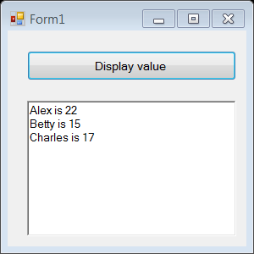
Example1 of Parallel Processing:
  We will combine all things we have learnt into a program to store name and age into arrays. Display them using FOR loop
BtnDisplay
txtDisplay
private void BtnDisplay_Click(object sender, EventArgs e)
{
string [] name = {"Alex", "Betty", "Charles"};
int [] age = {22,15,17};
string display;
for (int i=0; i < name.Length; i++)
{
display= name[i] + " is " + age[i] + "\n";
txtDisplay.AppendText(display);
}
}

Slide 21
Add in more array
Modify the program to:
Create another 2 arrays to store the students’ height and weight (use float data type).
Initialise the arrays with your own values.
Display all the data in the format below:
Alex age is 22, height is XX m, and weighs YY kg.
(XX and YY are your own values)

Slide 22
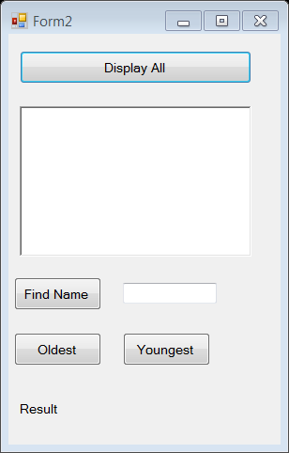
Example2 on Search, Find Max and Find Min
  The following example summarize all that we have learnt about array. We will explore finding value from array, finding maximum value and minimum value. Using parallel processing to retrieve the details.
BtnDisplay
txtDisplay
BtnFind
txtName
BtnOldest
BtnYoungest
LblResult

Slide 23
Code using class variable, display array details
// class variable
string[] name = { "Alex", "Betty", "Charles" };
int[] age = { 22, 15, 17 };
private void BtnDisplay_Click(object sender, EventArgs e)
{
string display;
for (int i = 0; i < name.Length; i++)
{
display = name[i] + " is " + age[i] + "\n";
txtDisplay.AppendText(display);
}
}
Name the class variables in the program.
Why do we need to use class variables?

Slide 24
Code on Search
private void BtnFind_Click(object sender, EventArgs e)
{
string findname, display=""; // initialise display as Null
findname = txtName.Text;
for (int i = 0; i < name.Length; i++)
{
if (findname == name[i]) // found
{
display = "Name found is " + name[i] + " age is " + age[i];
break; // exit the FOR loop
}
}
if (display == "") // name not found
{
display = "Name is not found.";
}
// display result;
LblResult.Text = display;
}
Tutor:
Debug the program to help students to
understand the code

Slide 25
Code on Find Max and display result
private void BtnOldest_Click(object sender, EventArgs e)
{
int max_value = age[0];
int max_index = 0;
string display;
for (int i = 1; i < name.Length; i++)
{
// value is greater than max_value
if (age[i] > max_value)
{
max_value = age[i];
max_index = i;
}
}
display = "The oldest is " + name[max_index] + " is "
+ age[max_index];
// display result;
LblResult.Text = display;
}
Tutor:
Debug the program to help students to
understand the code

Slide 26
Code on Find Min and display result
private void BtnYoungest_Click(object sender, EventArgs e)
{
int min_value = age[0];
int min_index = 0;
string display;
for (int i = 1; i < name.Length; i++)
{
// value is less than min_value
if (age[i] < min_value) {
min_value = age[i];
min_index = i;
}
}
display = "The youngest is " + name[min_index] + " is “
+ age[min_index];
// display result;
LblResult.Text = display;
}
Could you spot the differences in Find Youngest
And Find Oldest logic?

Slide 27
Advanced Array
Dynamic Sizing Arrays
  Size of array is not pre-coded
  Size is defined during run time
2D Arrays
  2 Dimensional Array
  It has row and column indexes
  It contains data in row and column
  It works together with nested FOR loop

Slide 28
Differentiated Learning:
Dynamic Sizing Array
Recall you create an empty array with this statement:
double [ ] sales = new double[5];
This will fix the size of the sales array to 5 elements.
You cannot change the size of the sales array after the program is run.
However, you can let the user decide the size of the array WHEN the program is run by doing this:
    // read the size from textbox
int size = int.Parse(txtSize.Text);
double [ ] sales = new double[size];
This is referred as DYNAMIC sizing.
Size MUST be a integer. It is the size of the array sales

Slide 29
Example: Dynamic sizing array
The following program reads in number of student, create a dynamic sized array of marks based on the number of student.
Program reads the index of mark and mark to be updated at index position. Program displays all the marks in a rich text box.
// Read number of student from text box
// dynamic sizing
int size = int.Parse( txtNumber.Text);
//IMPT – create array after reading of size
// data is initialized to 0
int [] marks = new int[size];
// To modify the data, read in the index entered by user
int index = int.Parse ( txtIndex.Text );
// Modify the value at the index position
marks[index] = int.Parse( txtMark.Text);
String display=“”;
// Display all records
for (int i=0; i<marks.Length; i++)
{
display = display + “Mark at ” + i + “ is ” + marks[i] + “\n”;
}
// Display records in rich text box
txtDisplay.Text = display;
}

Slide 30
2D-Arrays
Consider a table containing the marks scored by a class of students in each subject.
The marks of one student could be stored in a one-dimensional array:
  int NO_OF_SUBJ = 6;
  float [ ] mark = new float[NO_OF_SUBJ];
If we have many students, then we need to use many one dimension arrays; one array for each student:
float [ ] stud1Mark = new float[ NO_OF_SUBJ];
float [ ] stud2Mark = new float[ NO_OF_SUBJ];
float [ ] stud3Mark = new float[ NO_OF_SUBJ];
What do you need to do if you have 100 students?

Slide 31
2D-Arrays
  The solution is to have all marks of all the students could be stored in a
  2D or Two-dimensional array
  int NO_OF_STUD = 182;
  int NO_OF_SUBJ = 6;
  float [ , ] mark =
  new float [NO_OF_STUD , NO_OF_SUBJ];
  The program allocates 182 * 6 float of marks. That implies it creates 1092 marks.
  The Syntax to create 2D array:
dataType [ , ] arrayName = new dataType[ row, column ];
Where:
dataType – int, float, double, string etc.. etc..
arrayName – any valid variable name.
row, column – positive integer value

Slide 32
2D-Arrays
We can visualize a two-dimensional array as having rows and columns.
Each cell represents a memory space of data type float.
In this example, the rows represent the number of students (3 students) while the columns represent the different subjects (6 subjects).
The numbers in the cells are the marks of the student per subject.
To create the 2D array:
Column (subject)
0 1 2 3 4 5
Row
0
1
2
4.5
6.5
6.0
7.5
9.0
5.5
(student)
9.5
6.5
5.5
7.0
7.5
6.5
8.0
9.5
10.0
9.0
8.5
7.0
  float [ , ] mark = new float [3,6];

Slide 33
Summary
  How to apply loops to iterate through an array of elements.
  How to manipulate data in arrays to perform calculations eg total, comparison.
  To read from an Array, can use:
    foreach loop (NOT TESTED)
    for loop
  To store or write to an Array, can ONLY use:
    for loop
  Length property of an array.
  Allowing user to define array size.
  Processing arrays in parallel.
  Searching of an Array.
  Find Max and Min value
  Advanced Array :Dynamic Sizing Array and 2D Array

Slide 34
Mind Map – Array w Loop
For
For each
Length
Age.lenght
Num of element in array
Apply
Find element/ search
Find average / sum
Find max & min
Parallel processing
Multiple array of the same size
Retrieve data
Store & Read
Advanced Array
Dynamic Sizing Array
2D Array
Array with
Loop

Slide 35
Practical 2C
Spot the mistake in the C# code about 1D array and For Loop.
a) Range of indices in Array
int [] table = new int[10];
for (int index=0; index <=10; index++)
{
table[index] = 0;
}
Correction:

Slide 36
Practical 2C
b) For Loop index
float [] sales = new sales[6];
for (float index=0; index <6; index++)
{
sales[index] = 0;
}
Correction:
c) For Loop index
string [] apple = new string[4];
for (i=0; i <4; i++)
{
sales[i] = 0;
}
Correction:

Slide 37
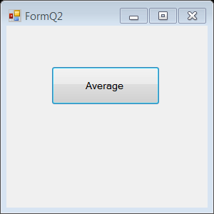
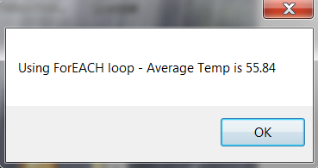
Practical 2C
2. Write a C# window application program that initialises an array with array name, temperature with the following values: 55.0, 77.5, 82.5, 28.5, 35.7.
Use a foreach loop to total up the values and calculate the average. When user clicks a Average button, it displays the average temperature in a message box.
3. Do the above question using a for loop.

Slide 38
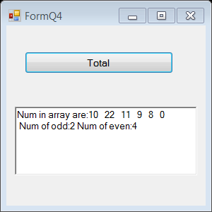
Practical 2C
4. Write a C# C# window application program to store 6 integers into an array named numbers.
  int [ ] numbers = {10,22,11,9,8,0};
For each value, determine whether it is an even or odd number. Total up the number of even and odd numbers. When user clicks on Total button it displays the numbers array, together with the total number of even and odd numbers found in a rich text box.
If you were to add in more numbers in the number array, which part of the code would you modify?

Slide 39
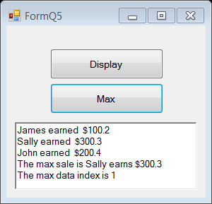
Practical 2C
5. Write a C# window application program to initialise an array, Sale to store the sale amount as follows { 100.20, 300.30, 200.40} and Name to store the Name as follows { “James”, “Sally”, “John”}.
a. When user clicks a Display button, it prints the result in a rich textbox as follows:
    James earned $100.20
    Sally earned $300.30
    John earned $200.40
b. When user clicks Max button it prints the max and sale data and its index in the above rich textbox.
E.g,
  The max sale is Sally earns $300.30.
  The max data index is 1.
You need to use 2 class variables of array to store the sale amounts and names.

Slide 40
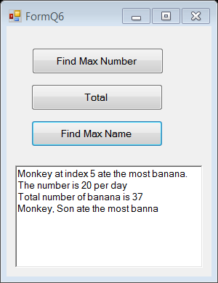
Practical 2C
6. Write a C# window application to keep track of number of banana ate by 7 monkeys in a zoo. Create an array named it as banana. It stores the number of banana per day and initialise it as {2,5,3,1,4,20,2}.
a. When user clicks Find Max Number button, it finds the monkey who ate the most banana and displays its index in a richtextbox. E.g
  Monkey at index 5 ate the most banana.
  The number is 20 per day
b. When user clicks on Total button, it calculates the total number of banana ate by all monkeys in the above richtextbox. E.g
  Total number of banana is 47
c. Add an array named as Name. It stores names of 7 monkeys. They are “Bon”,”Ton”,”Con”,”Won”,”Don”, “Son” and “Zon”. When user clicks on Find Max Name button, it prints the monkey’s name who ate the most and the number of banana it has eaten in the above richtextbox. E.g
  Monkey, Son ate the most banana.
You need to use 3 class variables.
They are 2 array and 1 int max_index

Slide 41
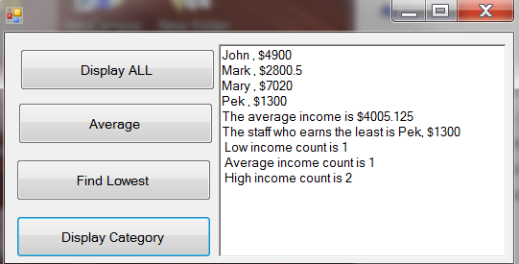
Practical 2C
Create a window application to capture the details
of 4 staff. Store it in 2 arrays named as Staff and Income.
When user clicks on Display All Button, use a For loop to display all records in a rich text box.
When user clicks on Average Button, it calculates the average income and displays it in the above richtextbox.
When user clicks on Find Lowest Button, it finds the lowest income. Displays the staff details who earns the least in the above richtextbox.
When user clicks on Display Category Button. It counts the number of staff based on the following category and displays it in the above richtextbox:
- earn less than $2000 (low income)
- earn from $2000 – 3000 (average income)
- earn more than $3000 (high income)
You need to use 2
class variables of
array
Name | Income $
John | 4900.00
Mark | 2800.50
Mary | 7020.00
Pek | 1300.00

Slide 42
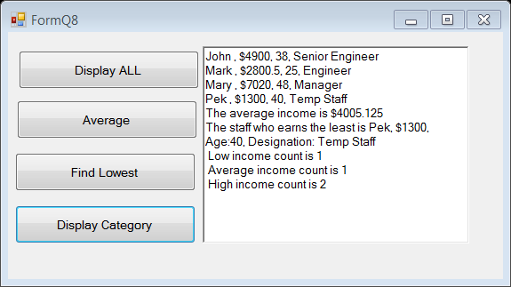
Practical 2C
8. Modify previous question to add in 2 more information for all staff. They are age and designation.
You need to declare 2 more arrays as class variable to store the additional information.
Initialise it with the data provided.
Modify the code to display the additional details (Age and Designation).
Name | Income $ | Age | Designation
John | 4900.00 | 38 | Senior Engineer
Mark | 2800.50 | 25 | Engineer
Mary | 7020.00 | 48 | Manager
Lim Ah Pek | 1300.00 | 40 | Temp staff

Slide 43
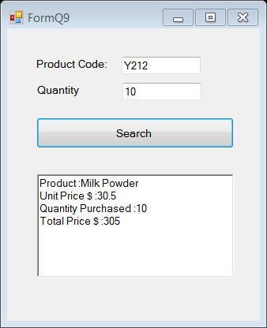
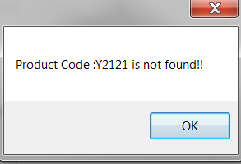
Practical 2C
9. A shop wants to computerize its inventory. Create a window application. Using 3 class variable arrays to capture the Product Code (eg. “x123”), the Product Name (eg. “Milk”) and the Unit Price (eg. 1.50).
The shop sells 5 items only.
Write a simple program to do the following:
  Intialize the 3 arrays with the values provided in Fig 1 (next page).
  User enters a product code and quantity.
  User clicks on Search button , program searchs for the Product Code in the array. If it is found, it calculates the Total Price (ie. Quantity x Unit Price).
  Display the result in a rich text box as follows:
  Unit Price: $xxxxxx
  Product Name: xxxxxxxxxxxxx
  Quantity Purchased: xxx
  Total Price: $xxxxxxxx
  Display appropriate error message, if item is not found.
Product found
Product Not found

Slide 44
Practical 2C
10. Modify previous question to enable user to update an item.
  User enters product index (i.e the array index 0-4), product code, name and price text boxes
  User clicks on Update product button, the record at index position will be updated with the new product code, name and price. Display appropriate error message for invalid index e.g 5.
  User clicks on Display All button, all records will be displayed.
  e.g product index entered is 0, product code is “X888” , product name is “Lotion”, price is 5.50. Item at index 0 will be updated with the entered data.
Product index
0
1
2
3
4
Product Code
X111
Y212
Y220
Z212
Y210
Product Name
“Baby
Lotion”
“Milk Powder”
“Diapers”
“Cotton wool”
“Baby
wipes”
Product Price
3.5f
30.5f
23.5f
3.0f
7.5f
This record will be updated with the new data
Fig 1

Slide 45
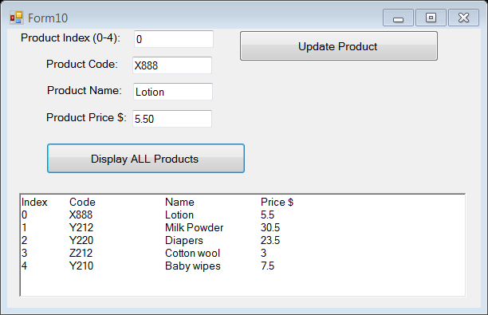
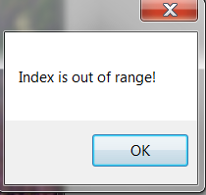
Practical 2C
User enters valid Product Index, product information is updated.
  Need to use PadRight(20) to align the text for display
User enters invalid Product Index, display error message

Slide 46
IT1762
Data Structures & Algorithms
End of Topic 2C
Array with FOR Loop

